Slide 1
story 4
File created on: 10/28/2023 3:32:39 PM

Slide 2
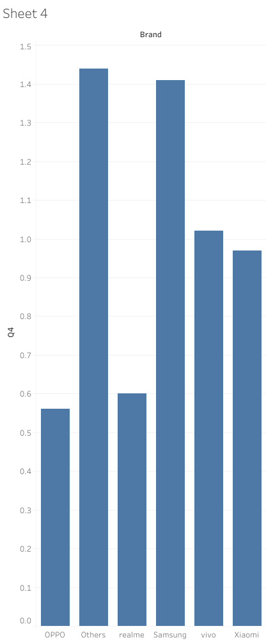

Slide 3
